Slide 1

Superstore Data Analysis using Power BI
Created by: Sheehan Mathur

Slide 2

Objectives of the Project
Purpose- Give business stakeholders a single, interactive view of Sales, Profit and Growth so they can spot margin pressure, high‑performing segments and emerging trends.
Scope: Superstore order data (2011‑2014, ≈10 k rows) sliced by time, product category, customer segment and region.
Deliverables: Power BI dashboard (with KPI cards, time‑series, drill‑downs & synced slicers) + a five‑slide summary deck, satisfying every requirement in the task brief .

Slide 3
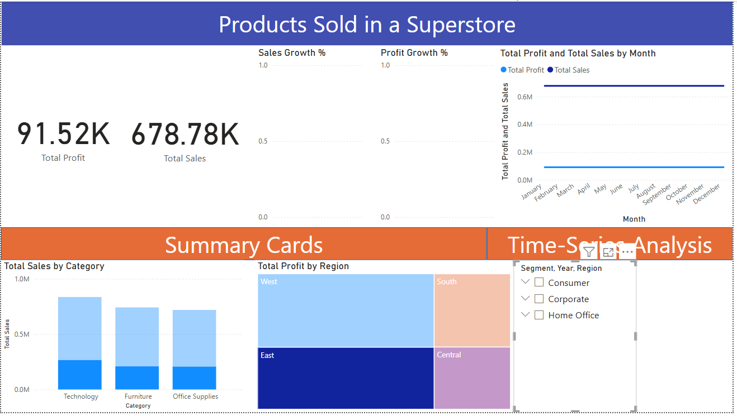
Dashboard Snapshot

Slide 4

Key Insights
Sales is not always profit: Furniture contributes almost a third of revenue yet only ≈ 8 % of total profit, indicating thin or negative margins in several sub‑categories.
High‑margin winners: Technology and Home‑Office products show the healthiest profit ratios, consistently out‑earning their share of sales.
Regional story: The West region delivers the largest absolute profit, while Central lags despite comparable sales volumes.
Shipping costs bite: Standard Class remains the dominant ship mode, but its profit margin has slipped in the most recent year, hinting at rising fulfilment costs.
Star sub‑categories: Phones, Copiers and Accessories top both sales and profit leader‑boards, whereas Tables and Bookcases often run at a loss

Slide 5
Recommendations
Raise Furniture margins
1
Review supplier contracts and cost structure.
Pilot a ~5 % price increase on loss‑making sub‑categories (e.g., Tables, Bookcases).
2. Share regional best practices
2
Use West‑region playbook to coach Central sales teams.
Set quarterly profit‑improvement targets and track in the dashboard.
3. Configure alerts for sudden margin drops or outlier discounts.
3

Slide 6
THE END
THANK YOU!

